Slide 1

 |  | TBC Furniture Company Ltd Office: 3/85 Binh Phu Street, Binh Chuan ward, Thuan An City, Binh Duong Provinve, Vietnam Tel: 0333.077.055 web: www.tbcvn.netEmail: info@tbcvn.net
TBC PRODUCT DEVELOPMENT
Person incharge : Nguyen Van Du (Richard Nguyen)
Cell phone: 0084 984 749749 (Whatsapp, viber)
Email: du@tbcvn.net
We can customizable products follow your idea

Slide 2
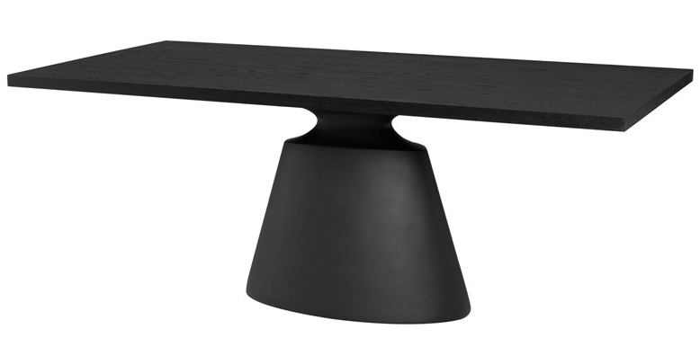
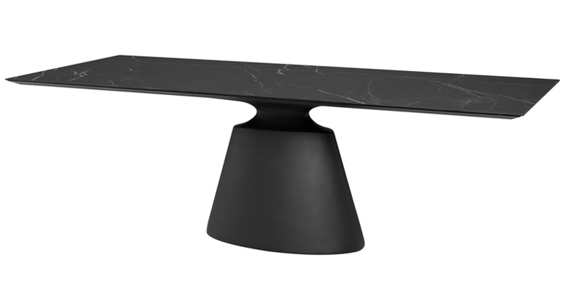
 | Dining Table The modern design carries the breath of immense nature. Bring nature into your home. PRODUCT DETAILS SKU: Collection: Item Weight : 110-120 kg Item Dimension : 2000 x 1020 x 750H (mm) Carton Dimension : Color(s) : Mat black Material(s) : Veneer top, Resin base
 | Dining Table The modern design carries the breath of immense nature. Bring nature into your home PRODUCT DETAILS SKU: Collection: Item Weight : 130-140 kg Item Dimension : 2000 x 1020 x 760H (mm) Carton Dimension : Color(s) : Mat black Material(s) : Top Grey top ceramic matte , Resin base

Slide 3
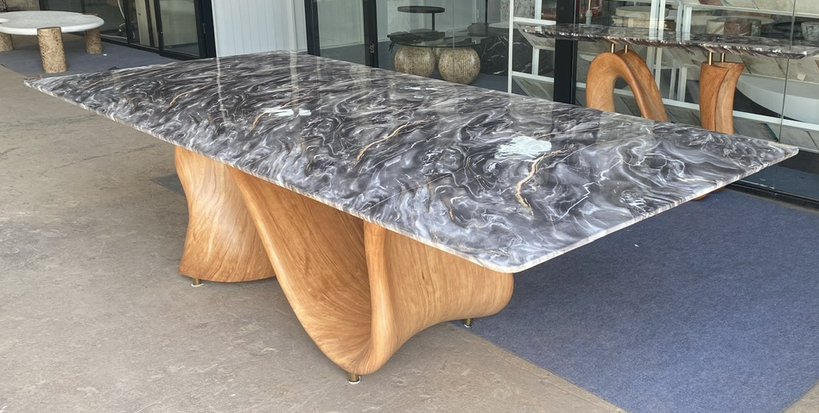
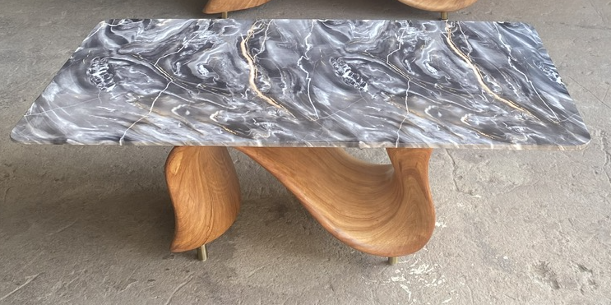
 | Dining Table The modern design carries the breath of immense nature. Bring nature into your home. PRODUCT DETAILS SKU: Collection: Item Weight : 130-140 kg Item Dimension : 2600 x 1200 x 750H (mm) Carton Dimension : Color(s) : High gloss Material(s) : Resin top faux marble, Resin base faux wood
 | Coffee Table The modern design carries the breath of immense nature. Bring nature into your home PRODUCT DETAILS SKU: Collection: Item Weight : 60-70 kg Item Dimension : 1300 x 700 x 420H (mm) Carton Dimension : Color(s) : High gloss Material(s) : Resin top faux marble, Resin base faux wood

Slide 4
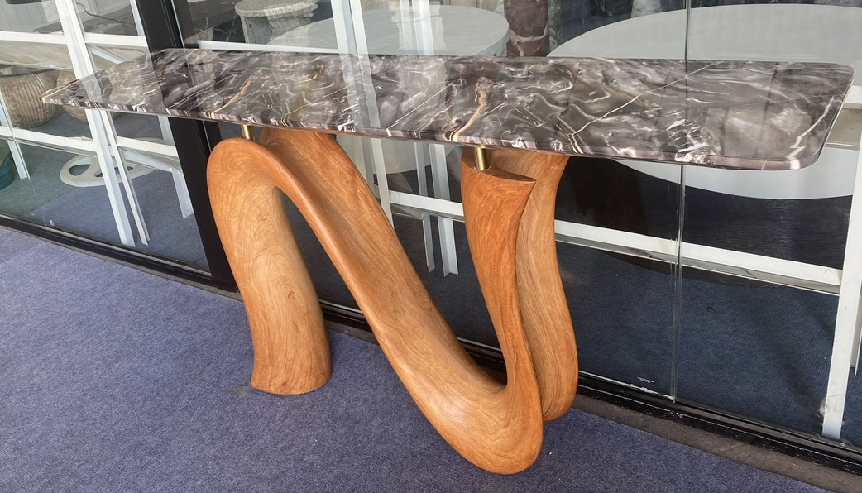
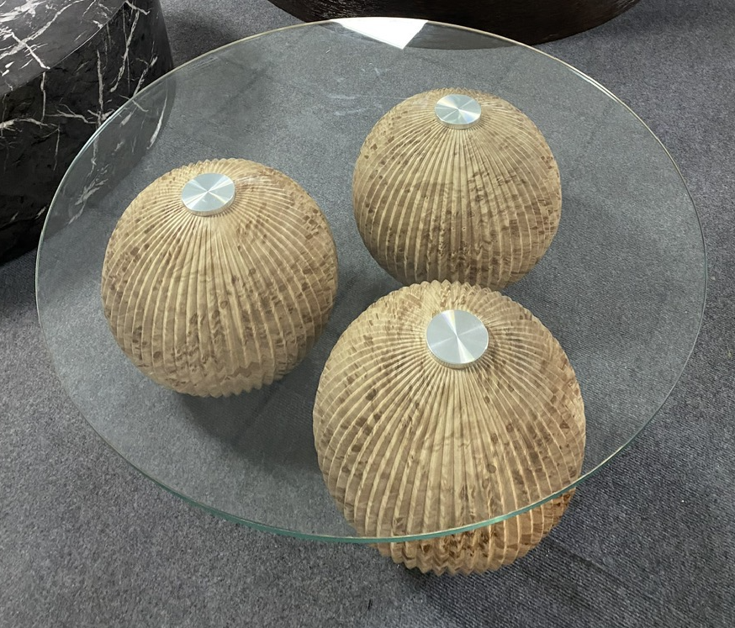
 | Consol Table The modern design carries the breath of immense nature. Bring nature into your home. PRODUCT DETAILS SKU: Collection: Item Weight : 60-70 kg Item Dimension : 1600 x 400 x 800H (mm) Carton Dimension : Color(s) : High gloss Material(s) : Resin top faux marble, Resin base faux wood
 | Coffee Table The modern design carries the breath of immense nature. Bring nature into your home PRODUCT DETAILS SKU: Collection: Item Weight : 50-60 kg Item Dimension : 900 x 400H (mm) Carton Dimension : Color(s) : Material(s) : Glass top, Resin base faux wood

Slide 5
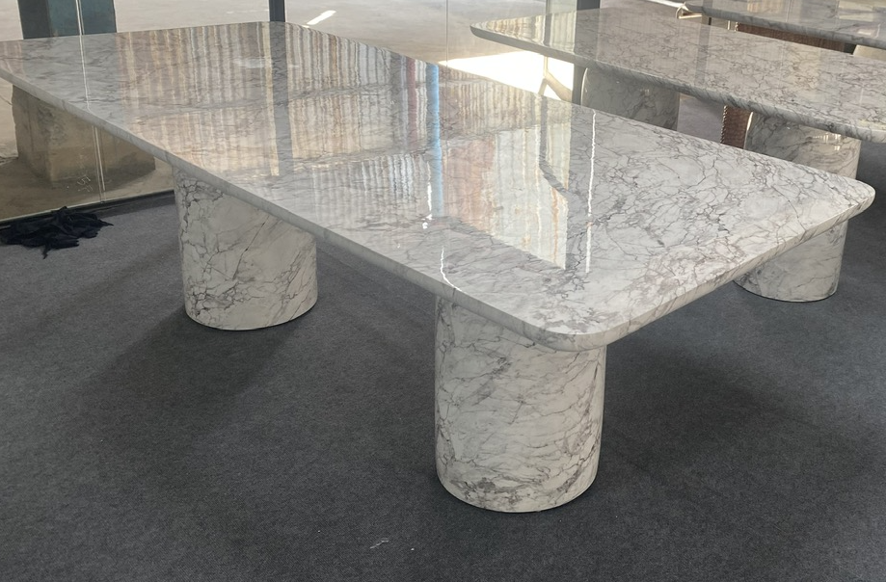
 | Dinning Table The modern design carries the breath of immense nature. Bring nature into your home. PRODUCT DETAILS SKU: Collection: Item Weight : 100-120 kg Item Dimension : 1800 x 970 x 750H (mm) Carton Dimension : Color(s) : High gloss Material(s) : Concrete faux marble
 | Dinning Table The modern design carries the breath of immense nature. Bring nature into your home PRODUCT DETAILS SKU: Collection: Item Weight : 120-130 kg Item Dimension : 2100 x 1010 x 760H (mm) Carton Dimension : Color(s) : High gloss Material(s) : Concrete faux marble

Slide 6
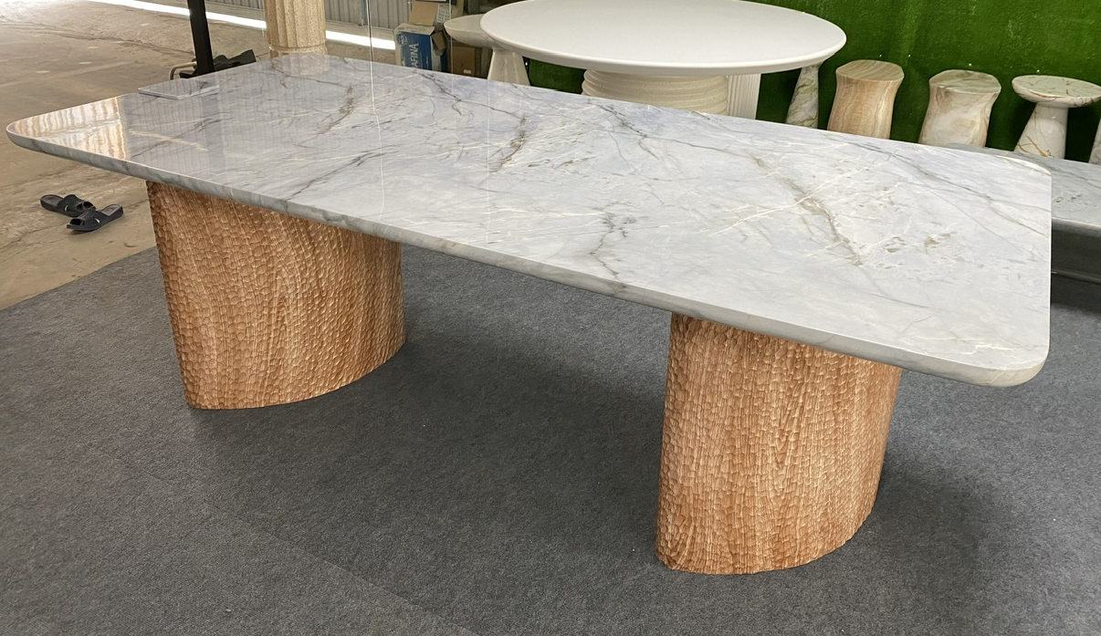
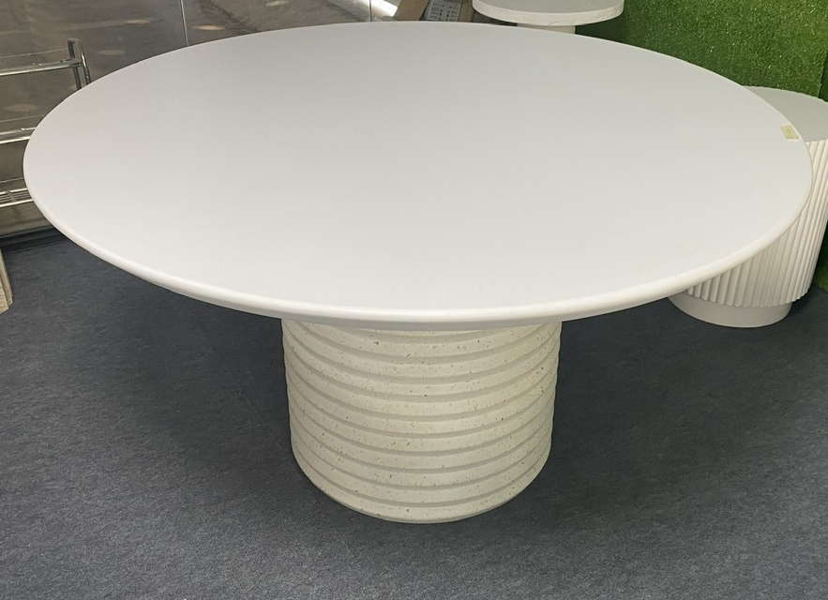
 | Dinning Table The modern design carries the breath of immense nature. Bring nature into your home. PRODUCT DETAILS SKU: Collection: Item Weight : 100-120 kg Item Dimension : 1800 x 970 x 750H (mm) Carton Dimension : Color(s) : High gloss Material(s) : Top Concrete faux marble, Base resin faux wood
 | Dinning Table The modern design carries the breath of immense nature. Bring nature into your home PRODUCT DETAILS SKU: Collection: Item Weight : 130-140 kg Item Dimension : 1400 x 760H (mm) Carton Dimension : Color(s) : Matt white Material(s) : Concrete

Slide 7
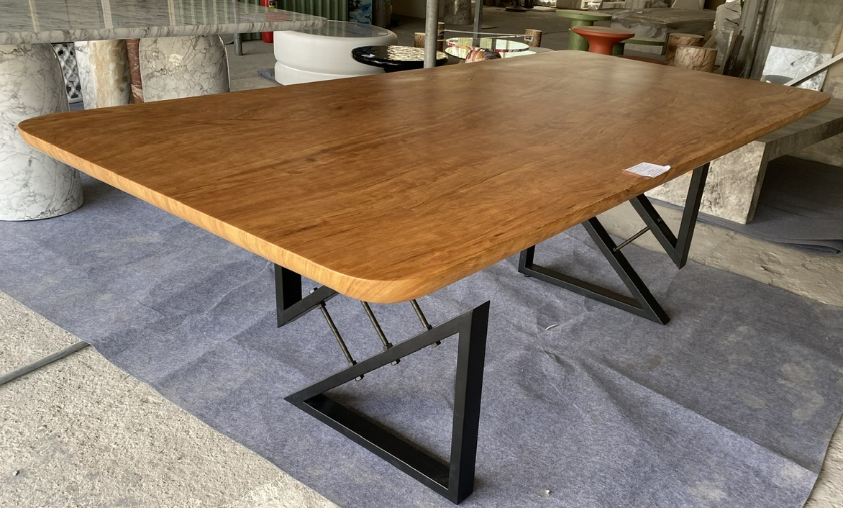
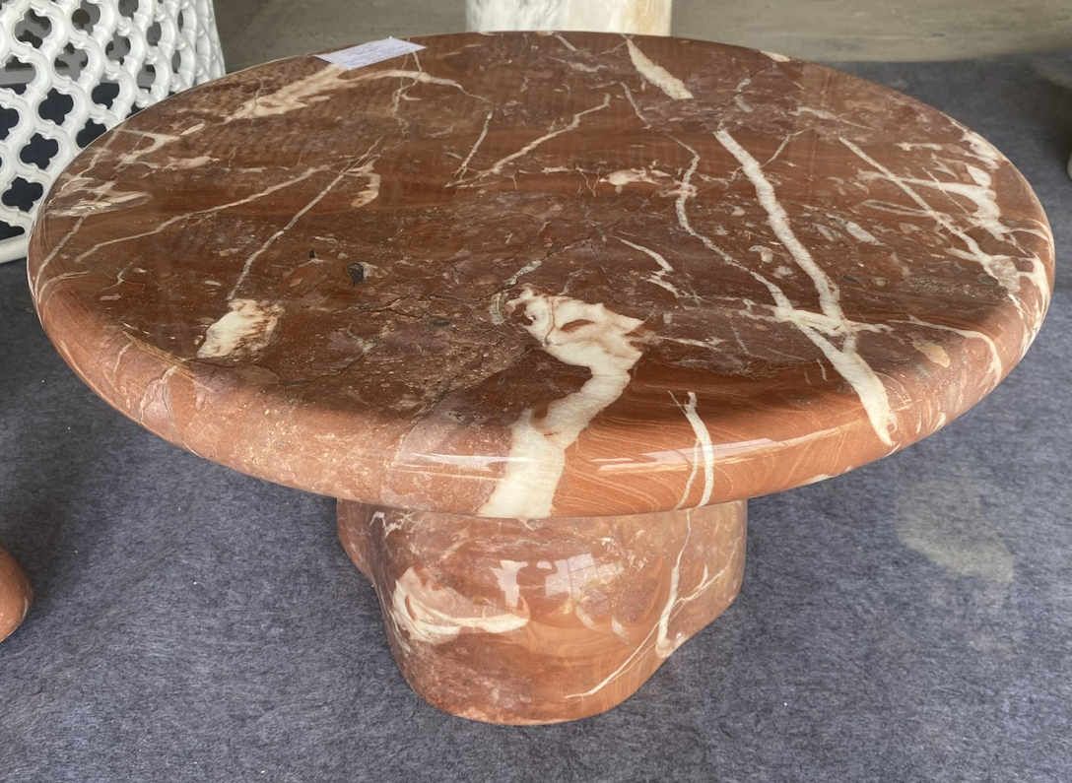
 | Dinning Table The modern design carries the breath of immense nature. Bring nature into your home. PRODUCT DETAILS SKU: Collection: Item Weight : 100-120 kg Item Dimension : 1800 x 970 x 750H (mm) Carton Dimension : Color(s) : Mat finishing Material(s) : Top Concrete faux wood, Base steel
 | Coffee Table The modern design carries the breath of immense nature. Bring nature into your home PRODUCT DETAILS SKU: Collection: Item Weight : 30-40 kg Item Dimension : 700 x 400H (mm) Carton Dimension : Color(s) : High gloss Material(s) : Concrete faux marble

Slide 8
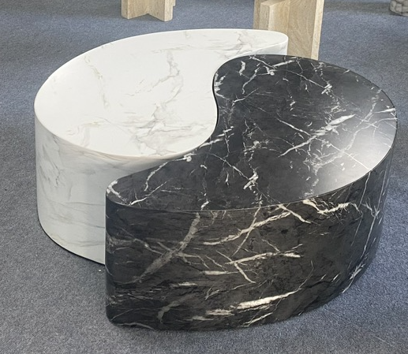
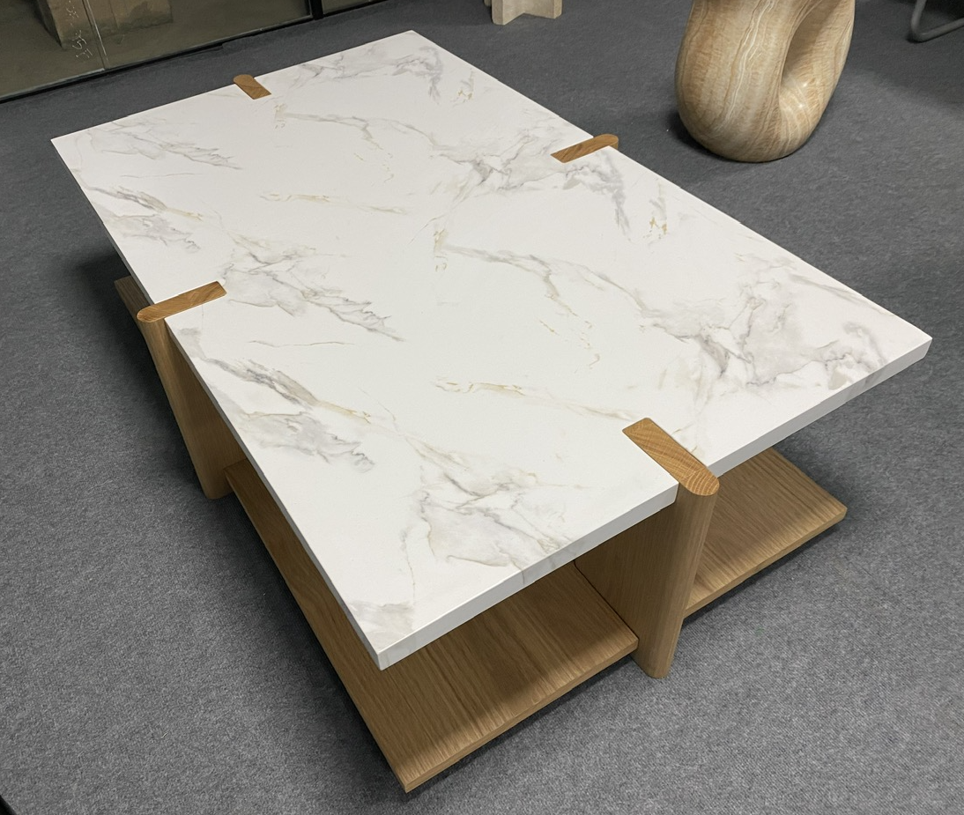
 | Round Coffee Table The modern design carries the breath of immense nature. Bring nature into your home. PRODUCT DETAILS SKU: Collection: Item Weight : 60-70 kg Item Dimension : 1000 x 1000 x 400H (mm) Carton Dimension : Color(s) : Material(s) : Concrete faux marble
 | Coffee Table The modern design carries the breath of immense nature. Bring nature into your home PRODUCT DETAILS SKU: Collection: Item Weight : 50-60 kg Item Dimension : 1400 x 890 x 410H (mm) Carton Dimension : Color(s) : Material(s) : Top Concrete faux marble, base MDF Oak Veneer

Slide 9
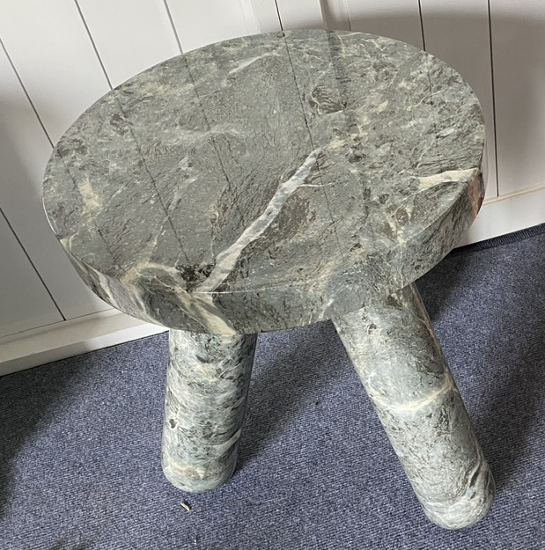
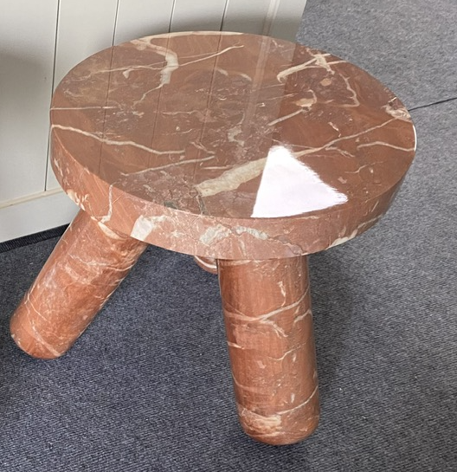
 | Side Table high The modern design carries the breath of immense nature. Bring nature into your home. PRODUCT DETAILS SKU: Collection: Item Weight : 30-50 kg Item Dimension : 406 x 406 x 440H (mm) Carton Dimension : Color(s) : high gloss Material(s) : Concrete faux marble
 | Coffee Table The modern design carries the breath of immense nature. Bring nature into your home PRODUCT DETAILS SKU: Collection: Item Weight : 50-60 kg Item Dimension : 406 x 406 x 350H (mm) Carton Dimension : Color(s) : high gloss Material(s) : Concrete faux marble

Slide 10
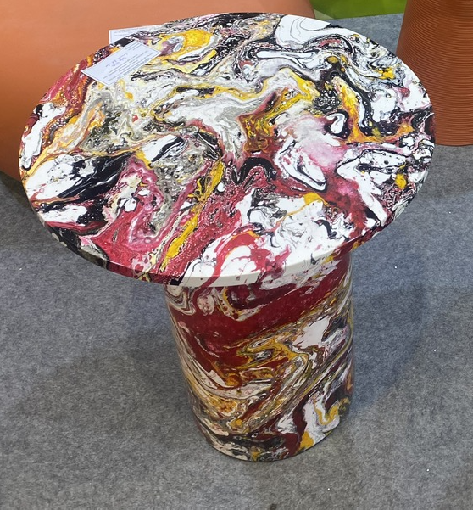
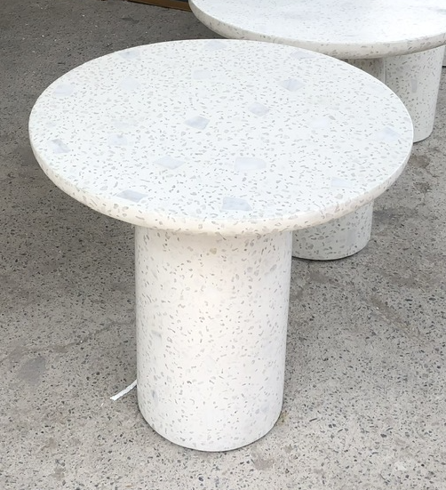
 | Side Table The modern design carries the breath of immense nature. Bring nature into your home. PRODUCT DETAILS SKU: Collection: Item Weight : 50-60 kg Item Dimension : 610 x 605H (mm) Carton Dimension : Color(s) : high gloss Material(s) : Concrete faux marble
 | Coffee Table The modern design carries the breath of immense nature. Bring nature into your home PRODUCT DETAILS SKU: Collection: Item Weight : 50-60 kg Item Dimension : 610 x 605H (mm) Carton Dimension : Color(s) : Material(s) : Concrete terrazzo

Slide 11
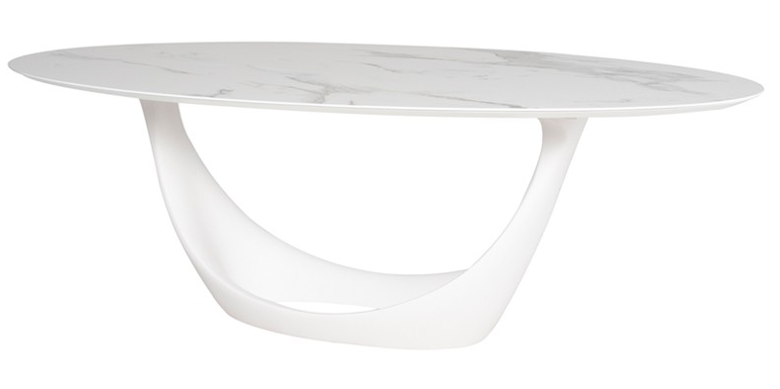
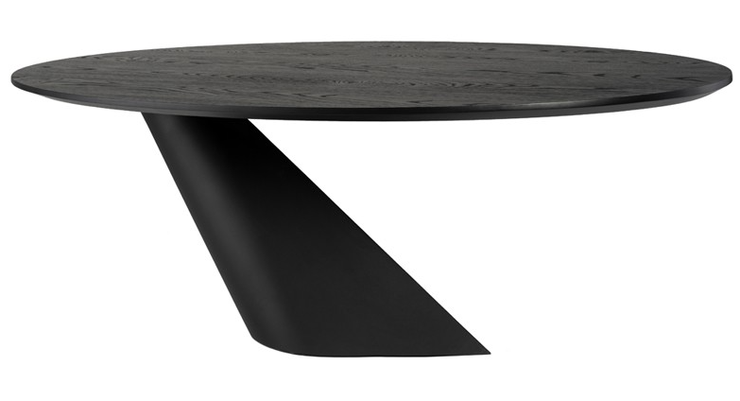
 | Dining Table The modern design carries the breath of immense nature. Bring nature into your home. PRODUCT DETAILS SKU: Collection: Item Weight : 90-100 kg Item Dimension : 2340 x 1170 x 760H (mm) Carton Dimension : Color(s) : Mat white Material(s) : top ceramic matte OVAL, Resin base
 | Dining Table The modern design carries the breath of immense nature. Bring nature into your home PRODUCT DETAILS SKU: Collection: Item Weight : 130-140 kg Item Dimension : 2000 x 1020 x 750H (mm) Carton Dimension : Color(s) : Mat black Material(s) : Veneer top, Resin base

Slide 12
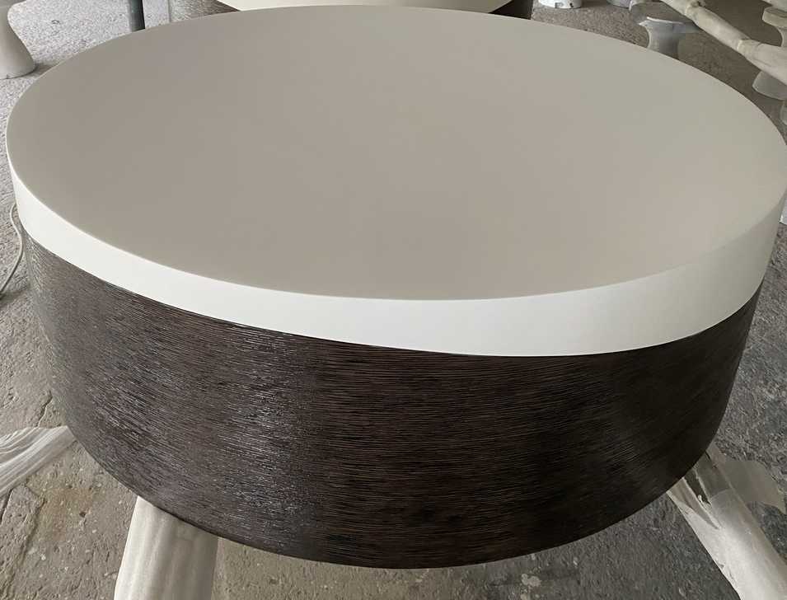
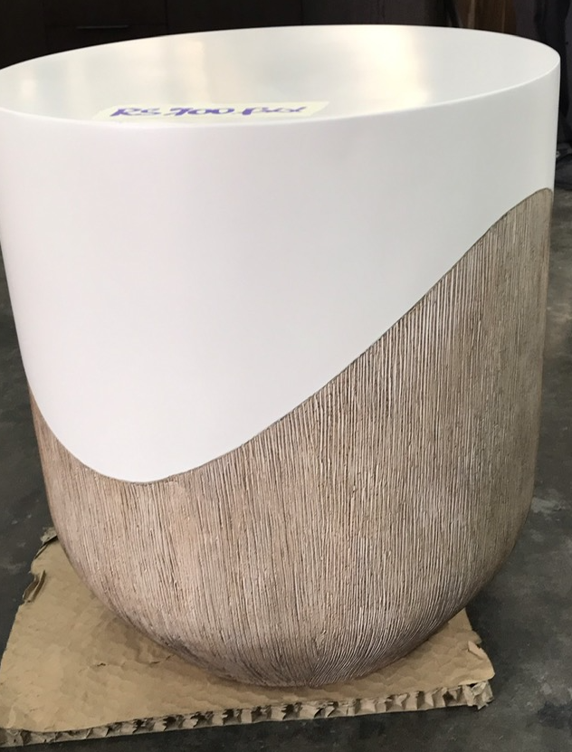
 | Round Coffee Table The modern design carries the breath of immense nature. Bring nature into your home. PRODUCT DETAILS SKU: Collection: Item Weight : 40-50 kg Item Dimension : dia 1270 x 406H (mm) Carton Dimension : Color(s) : Wood grain touchable at bottom, mat white on top Material(s) : Poly resin
 | Round Accent Table The modern design carries the breath of immense nature. Bring nature into your home PRODUCT DETAILS SKU: Collection: Item Weight : 20-25 kg Item Dimension : 457 x 508H (mm) Carton Dimension : Color(s) : Wood grain touchable at bottom, mat white on top Material(s) : Poly resin

Slide 13
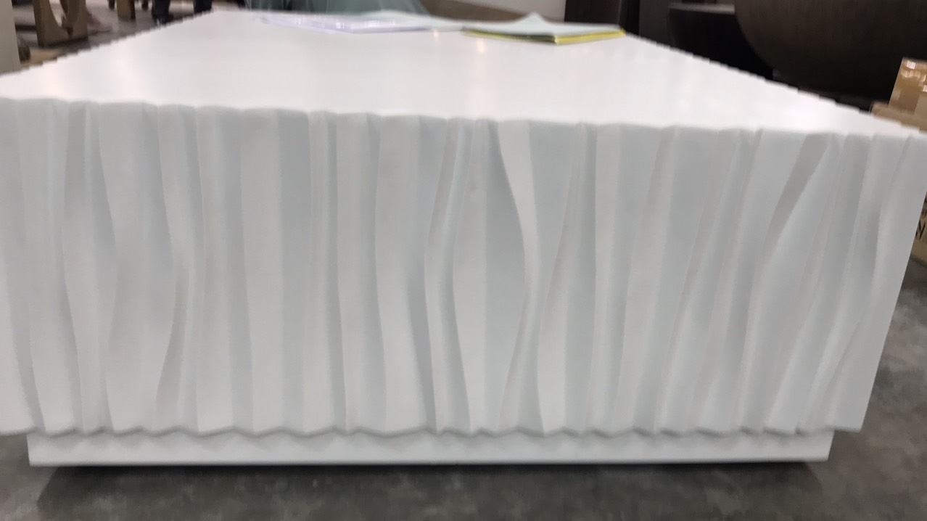
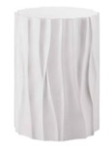
 | Square Coffee Table The modern design carries the breath of immense nature. Bring nature into your home. PRODUCT DETAILS SKU: Collection: Item Weight : 40-50 kg Item Dimension : 1219 x 1219 x 406H (mm) Carton Dimension : Color(s) : mat white on top Material(s) : Poly resin
 | Round Accent Table The modern design carries the breath of immense nature. Bring nature into your home PRODUCT DETAILS SKU: Collection: Item Weight : 20-25 kg Item Dimension : 457 x 533H (mm) Carton Dimension : Color(s) : mat white Material(s) : Poly resin

Slide 14
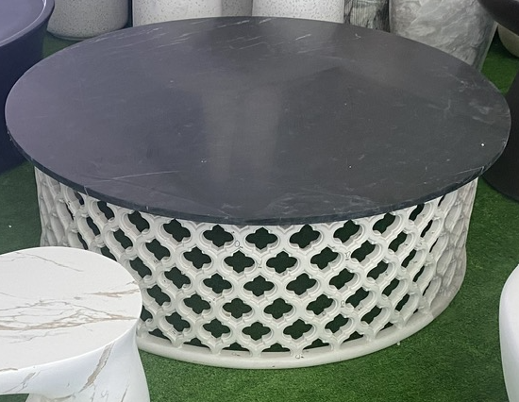
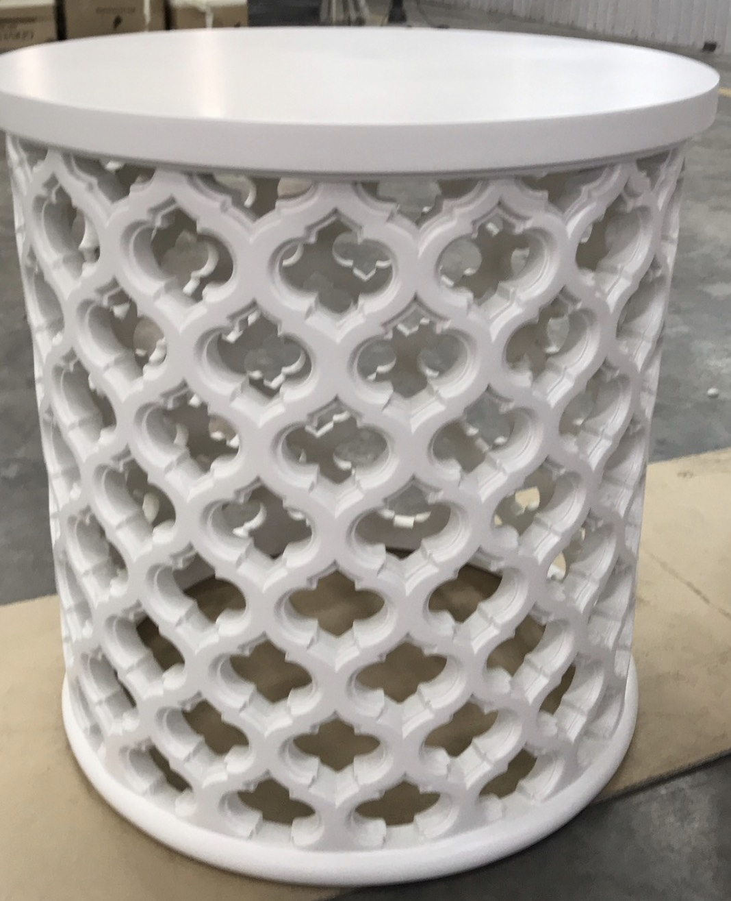
 | Round Cocktail Table The modern design carries the breath of immense nature. Bring nature into your home. PRODUCT DETAILS SKU: Collection: Item Weight : 40-50 kg Item Dimension : Dia 1067 x 406H (mm) Carton Dimension : Color(s) : mat white Material(s) : Poly resin
 | Round Accent Table The modern design carries the breath of immense nature. Bring nature into your home PRODUCT DETAILS SKU: Collection: Item Weight : 20-25 kg Item Dimension : 508 x 533H (mm) Carton Dimension : Color(s) : mat white Material(s) : Poly resin

Slide 15
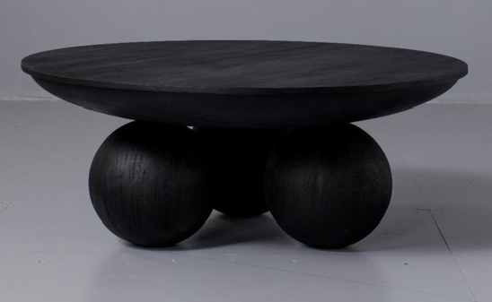
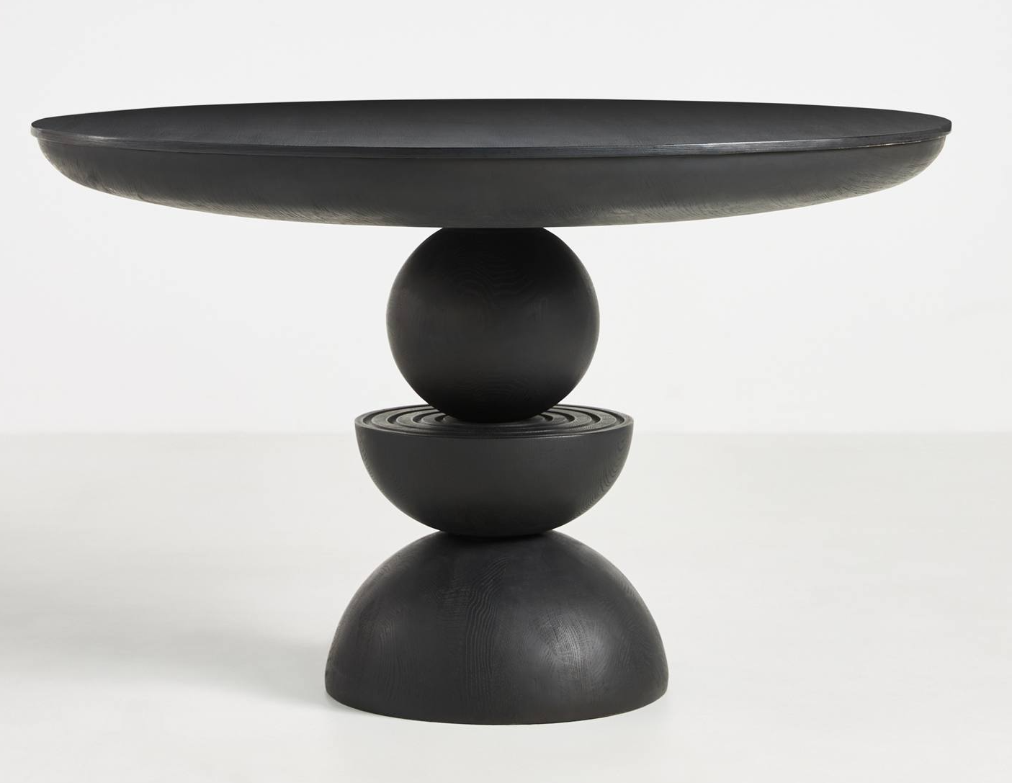
 | Round Cocktail Table The modern design carries the breath of immense nature. Bring nature into your home. PRODUCT DETAILS SKU: Collection: Item Weight : 50-60 kg Item Dimension : Dia 951 x 375H (mm) Carton Dimension : Color(s) : mat black, Wood grain touchable Material(s) : Poly resin
 | Round Dinning Table The modern design carries the breath of immense nature. Bring nature into your home PRODUCT DETAILS SKU: Collection: Item Weight : 70-80 kg Item Dimension : Dia 1200 x 75H (mm) Carton Dimension : Color(s) : mat black, Wood grain touchable Material(s) : Poly resin

Slide 16
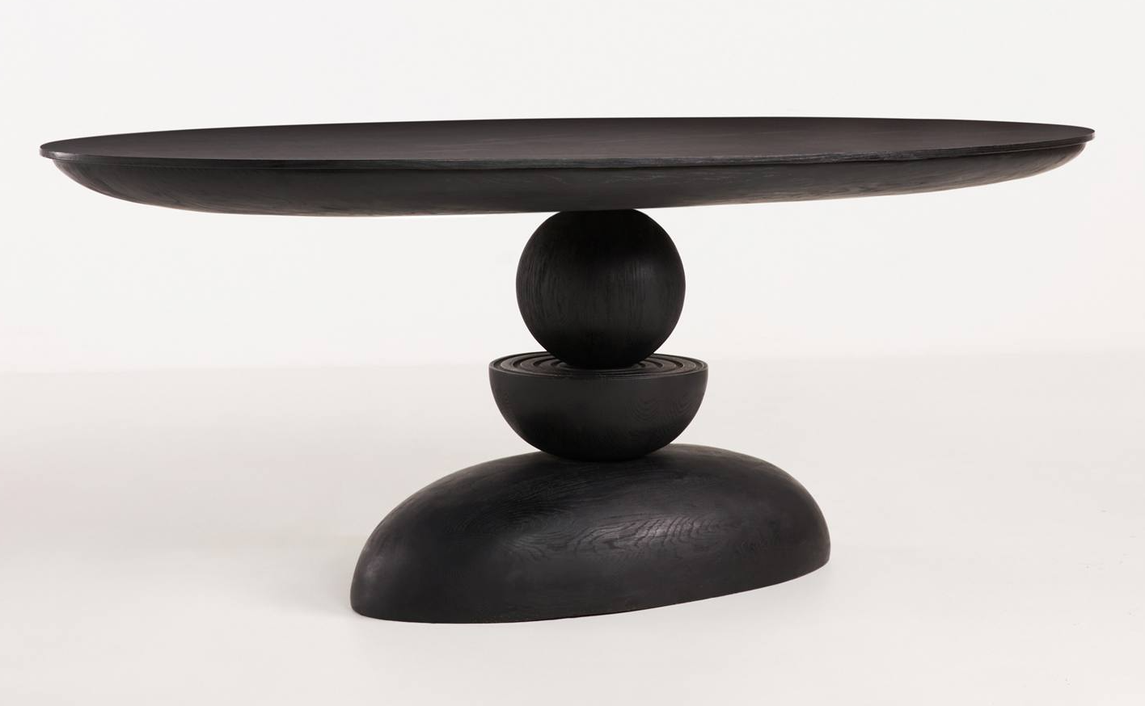
 | Oval Dinning Table The modern design carries the breath of immense nature. Bring nature into your home. PRODUCT DETAILS SKU: Collection: Item Weight : 40-50 kg Item Dimension : 1967 x 1053 x 753H (mm) Carton Dimension : Color(s) : mat black, Wood grain touchable Material(s) : Poly Resin
 | Round Dinning Table The modern design carries the breath of immense nature. Bring nature into your home PRODUCT DETAILS SKU: Collection: Item Weight : 70-85 kg Item Dimension : Dia 1219 x 762H (mm) Carton Dimension : Color(s) : mat white Material(s) : Poly resin

Slide 17
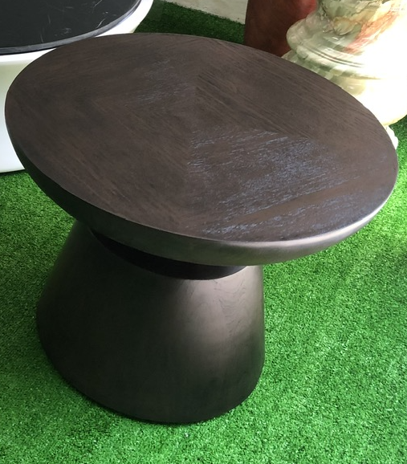
 | Round Cocktail Table The modern design carries the breath of immense nature. Bring nature into your home. PRODUCT DETAILS SKU: Collection: Item Weight : 40-50 kg Item Dimension : Dia 700 x 560H (mm) Carton Dimension : Color(s) : mat black, Wood grain touchable Material(s) : Poly resin
 | Round Accent Table The modern design carries the breath of immense nature. Bring nature into your home PRODUCT DETAILS SKU: Collection: Item Weight : 30-40 kg Item Dimension : Dia 400 x 550H (mm) Carton Dimension : Color(s) : mat black, Wood grain touchable Material(s) : Poly resin

Slide 18
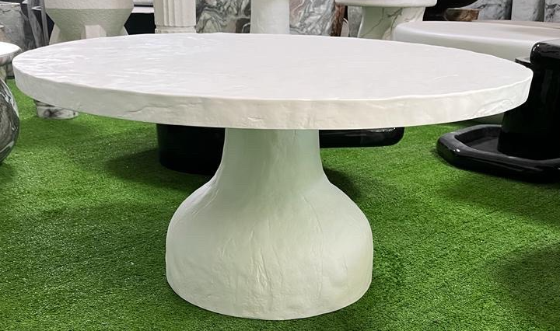
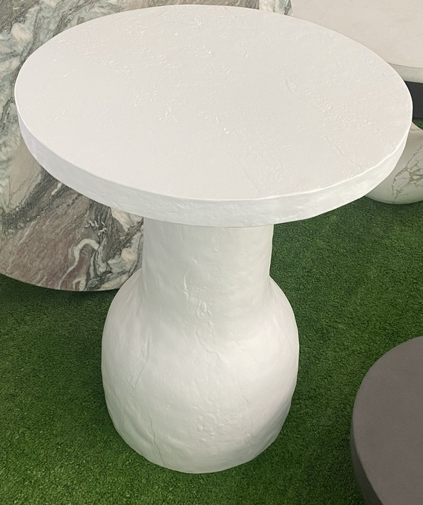
 | Round Cocktail Table The modern design carries the breath of immense nature. Bring nature into your home. PRODUCT DETAILS SKU: Collection: Item Weight : 40-50 kg Item Dimension : 960 x 960 x 40H (mm) Carton Dimension : Color(s) : Rough/uneven surface finishing Material(s) : Concrete
 | Round Accent Table The modern design carries the breath of immense nature. Bring nature into your home PRODUCT DETAILS SKU: Collection: Item Weight : 30-40 kg Item Dimension : 508 x 508 x 600H (mm) Carton Dimension : Color(s) : Rough/uneven surface finishing Material(s) : Concrete

Slide 19
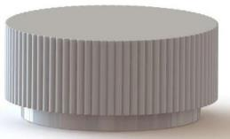
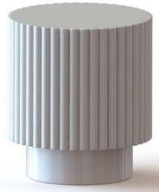
 | Round Coffee Table The modern design carries the breath of immense nature. Bring nature into your home. PRODUCT DETAILS SKU: Collection: Item Weight : 40-50 kg Item Dimension : 900 x 900 x 400H (mm) Carton Dimension : 1015 x 1015 x 515H mm Color(s) : Smooth look Material(s) : Concrete
 | Round Accent Table The modern design carries the breath of immense nature. Bring nature into your home PRODUCT DETAILS SKU: Collection: Item Weight : 30-40 kg Item Dimension : 450 x 450 x 500H (mm) Carton Dimension : 565 x 565 x 615H mm Color(s) : Smooth look Material(s) : Concrete

Slide 20
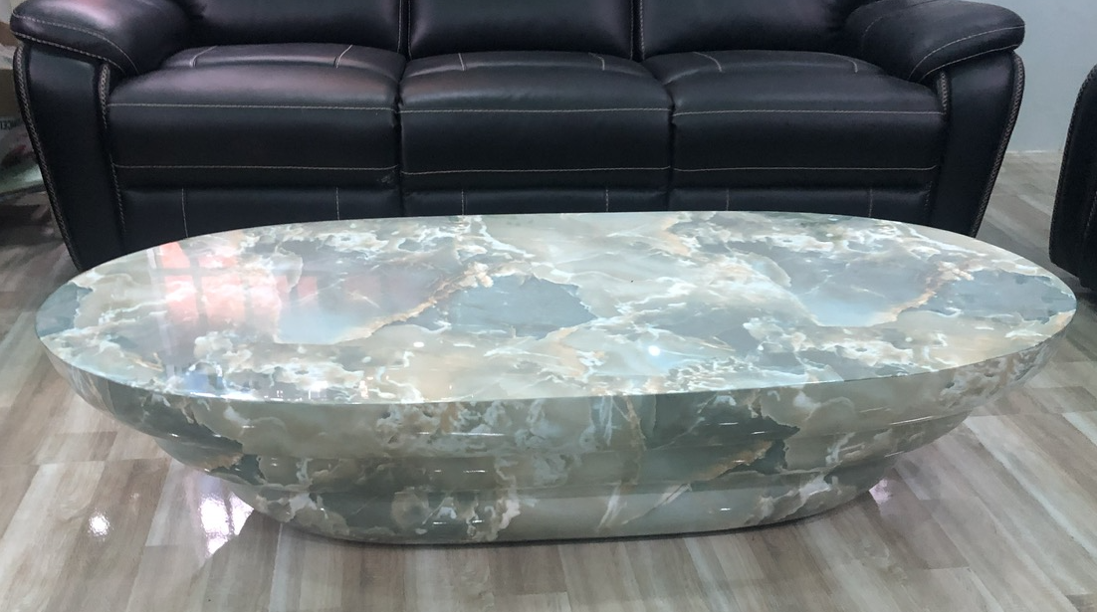
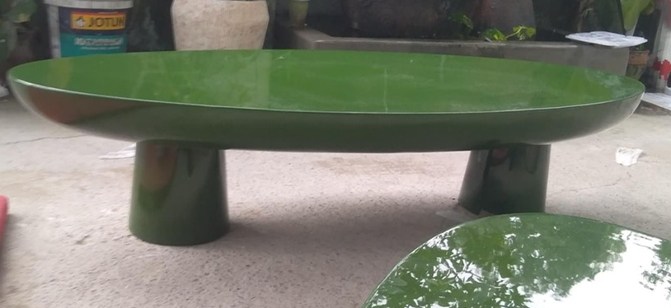
 | Oval Coffee Table The modern design carries the breath of immense nature. Bring nature into your home. PRODUCT DETAILS SKU: Collection: Item Weight : 40-50 kg Item Dimension : 1500 x 605 x 340H (mm) Carton Dimension : Color(s) : Faux marble Material(s) : Concrete
 | Oval Coffee Table The modern design carries the breath of immense nature. Bring nature into your home PRODUCT DETAILS SKU: Collection: Item Weight : 70-85 kg Item Dimension : 1500 x 605 x 340H (mm) Carton Dimension : Color(s) : High gloss Material(s) : Concrete

Slide 21
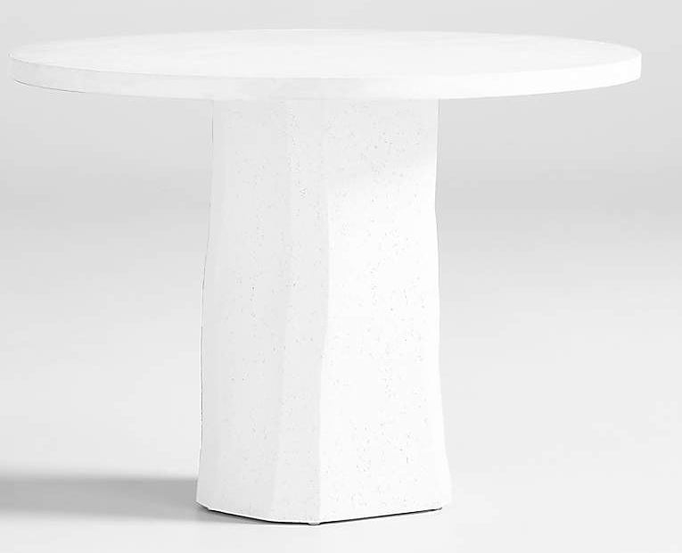
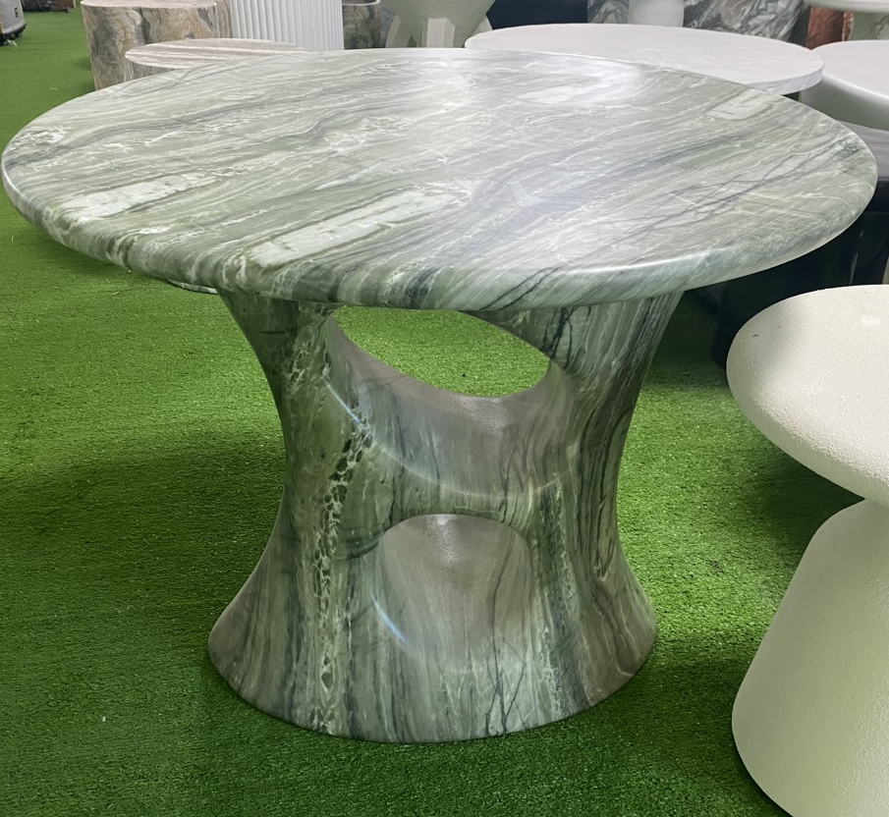
 | Round Dinning Table The modern design carries the breath of immense nature. Bring nature into your home. PRODUCT DETAILS SKU: Collection: Item Weight : 50-65 kg Item Dimension : Dia 1050 x 760H (mm) Carton Dimension : Color(s) : Mat white Material(s) : Concrete
 | Round Coffe Table The modern design carries the breath of immense nature. Bring nature into your home PRODUCT DETAILS SKU: Collection: Item Weight : 60-65 kg Item Dimension : Dia 890 x 690H (mm) Carton Dimension : Color(s) : Faux marble Material(s) : Concrete

Slide 22
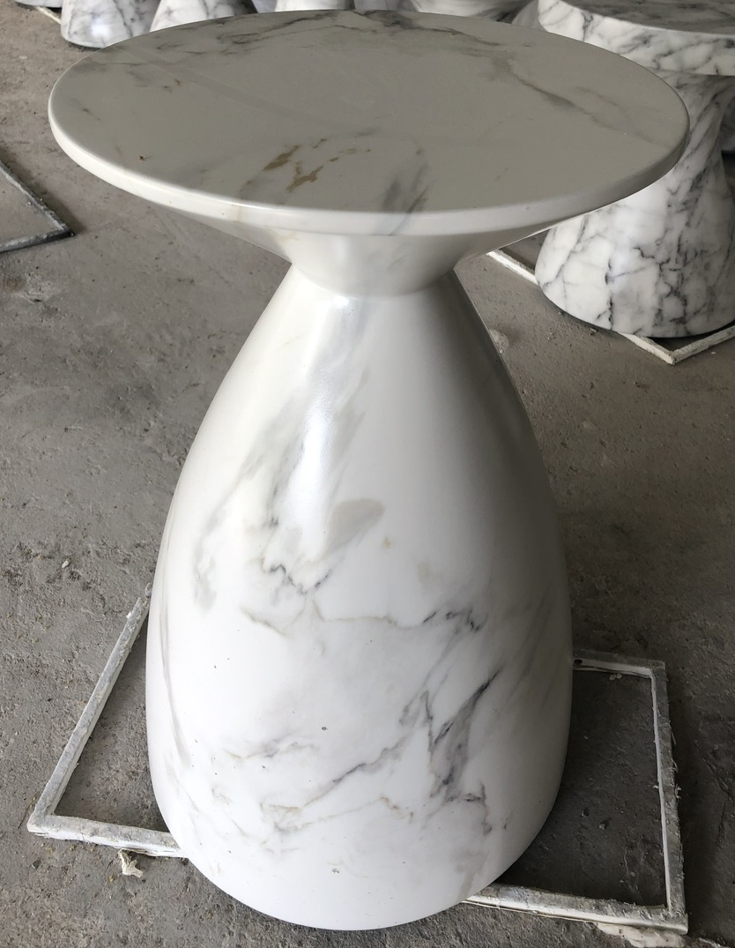
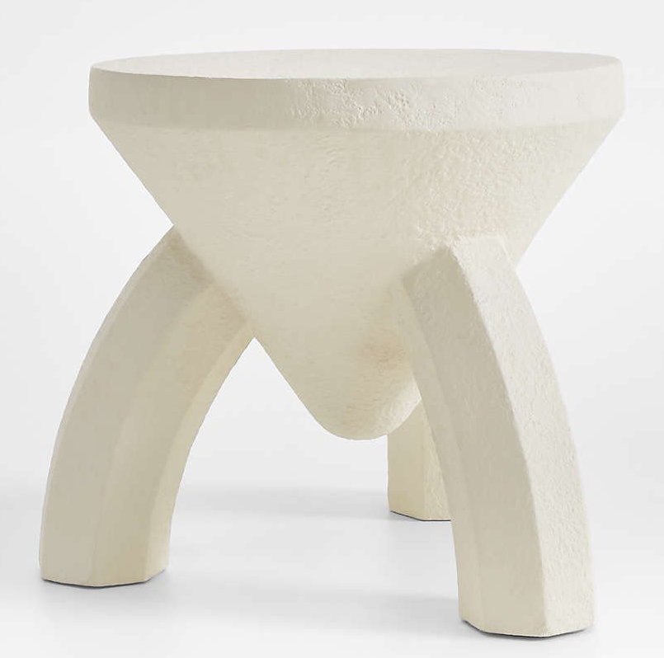
 | Accent Table The modern design carries the breath of immense nature. Bring nature into your home. PRODUCT DETAILS SKU: Collection: Item Weight : 30-35 kg Item Dimension : Dia 510 x 500H (mm) Carton Dimension : Color(s) : Faux marble Material(s) : Concrete
 | Side Table The modern design carries the breath of immense nature. Bring nature into your home PRODUCT DETAILS SKU: Collection: Item Weight : 20-35 kg Item Dimension : Dia 500 x 480H (mm) Carton Dimension : Color(s) : Mat white Material(s) : Concrete

Slide 23
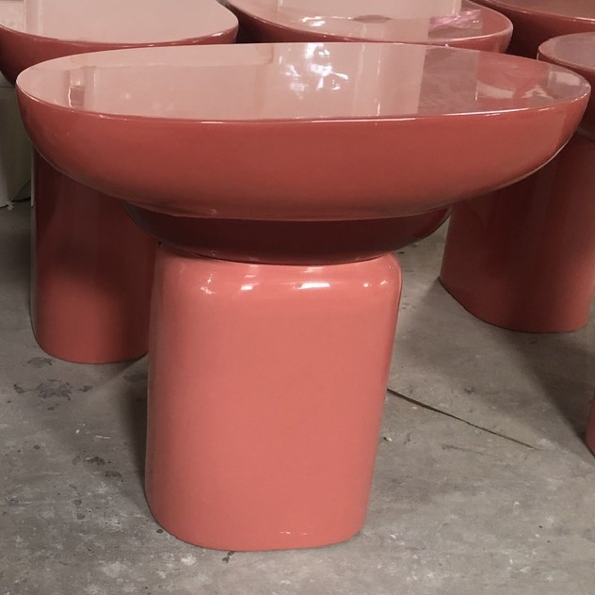
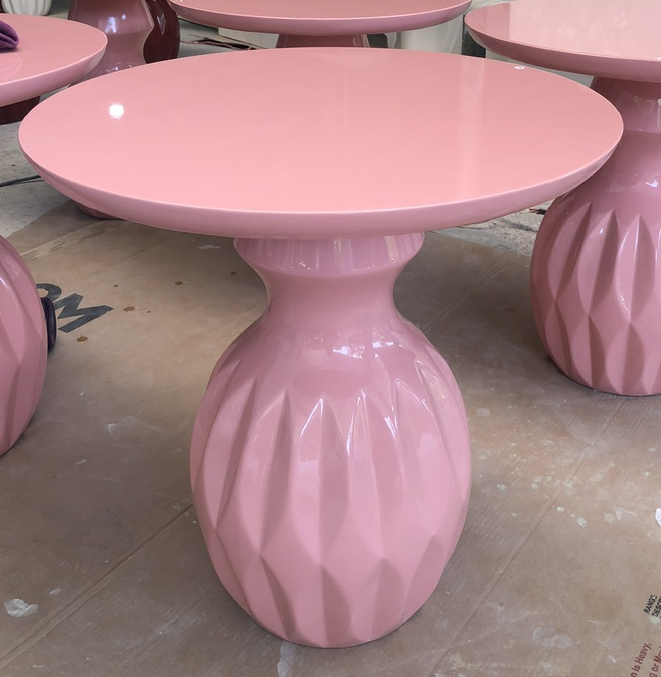
 | Oval Accent Table The modern design carries the breath of immense nature. Bring nature into your home. PRODUCT DETAILS SKU: Collection: Item Weight : 20-25 kg Item Dimension : 600 x 320 x 500H (mm) Carton Dimension : Color(s) : High glossy Material(s) : Concrete
 | Round Dinning Table The modern design carries the breath of immense nature. Bring nature into your home PRODUCT DETAILS SKU: Collection: Item Weight : 20-35 kg Item Dimension : Dia 520 x 520H (mm) Carton Dimension : Color(s) : High glossy Material(s) : Concrete

Slide 24
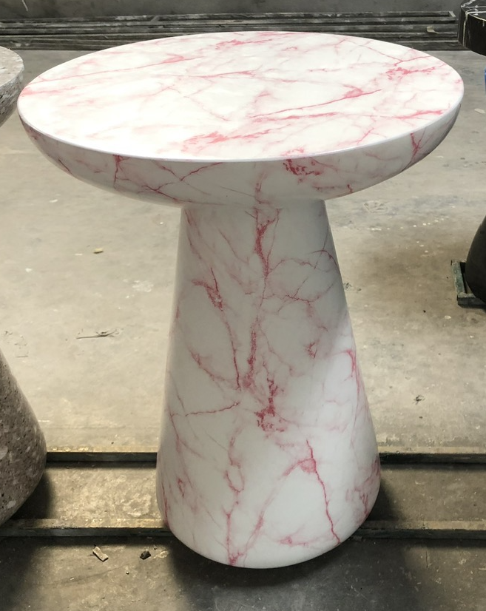
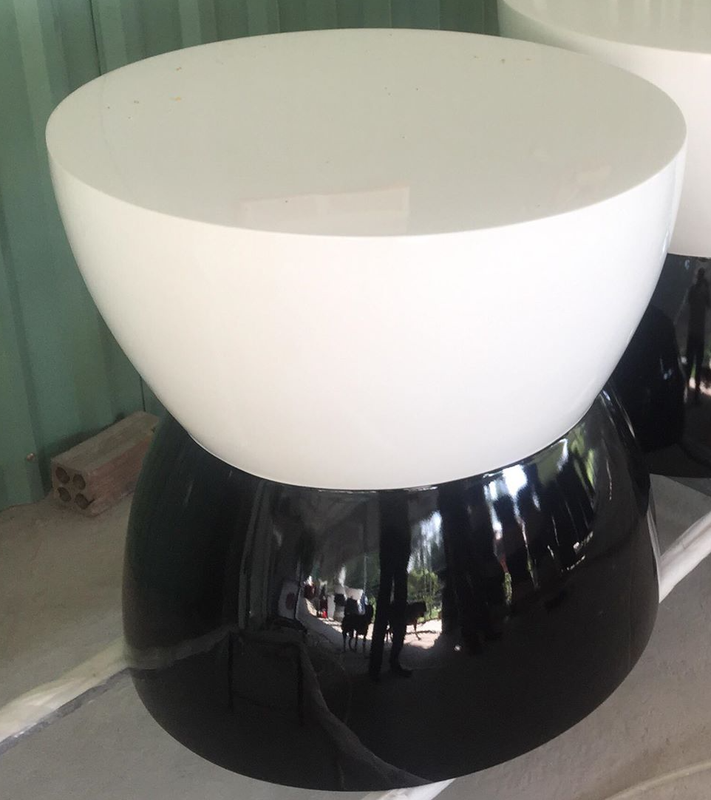
 | Round side Table The modern design carries the breath of immense nature. Bring nature into your home. PRODUCT DETAILS SKU: Collection: Item Weight : 20-25 kg Item Dimension : Dia 360 x 480H (mm) Carton Dimension : Color(s) : Faux marble Material(s) : Concrete
 | Round Coffe Table The modern design carries the breath of immense nature. Bring nature into your home PRODUCT DETAILS SKU: Collection: Item Weight : 20-35 kg Item Dimension : Dia 490 x 490H (mm) Carton Dimension : Color(s) : High glossy Material(s) : Concrete

Slide 25
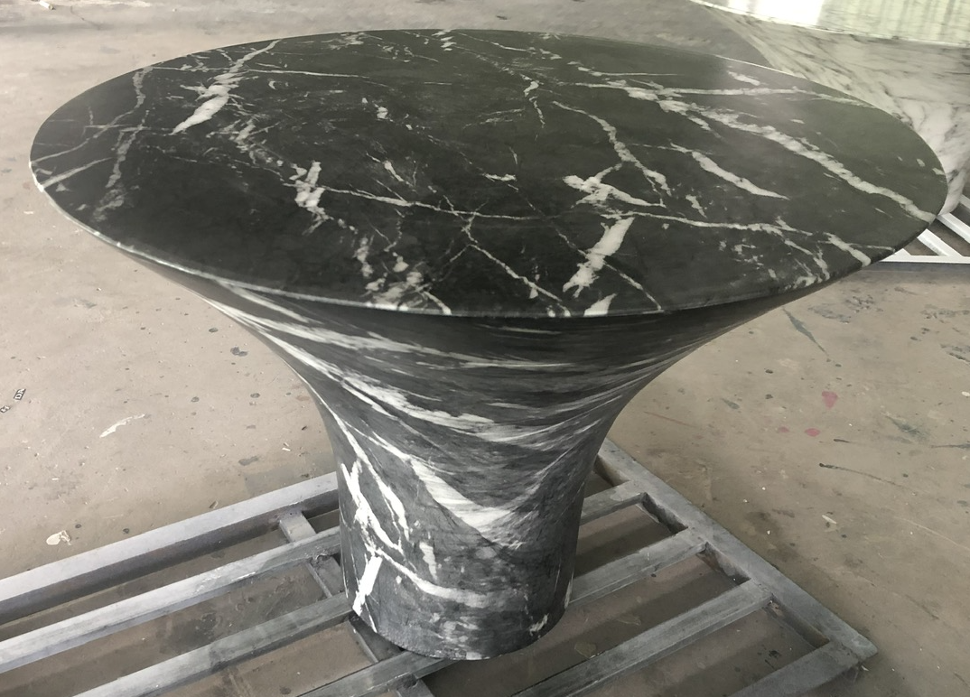
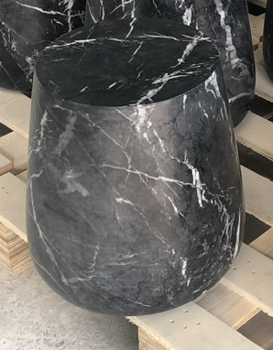
 | Round Coffe Table The modern design carries the breath of immense nature. Bring nature into your home. PRODUCT DETAILS SKU: Collection: Item Weight : 20-25 kg Item Dimension : Dia 917 x 370H (mm) Carton Dimension : Color(s) : Faux marble Material(s) : Concrete
 | Round side Table The modern design carries the breath of immense nature. Bring nature into your home PRODUCT DETAILS SKU: Collection: Item Weight : 20-35 kg Item Dimension : Dia 380 x 410H (mm) Carton Dimension : Color(s) : Faux marble Material(s) : Concrete

Slide 26
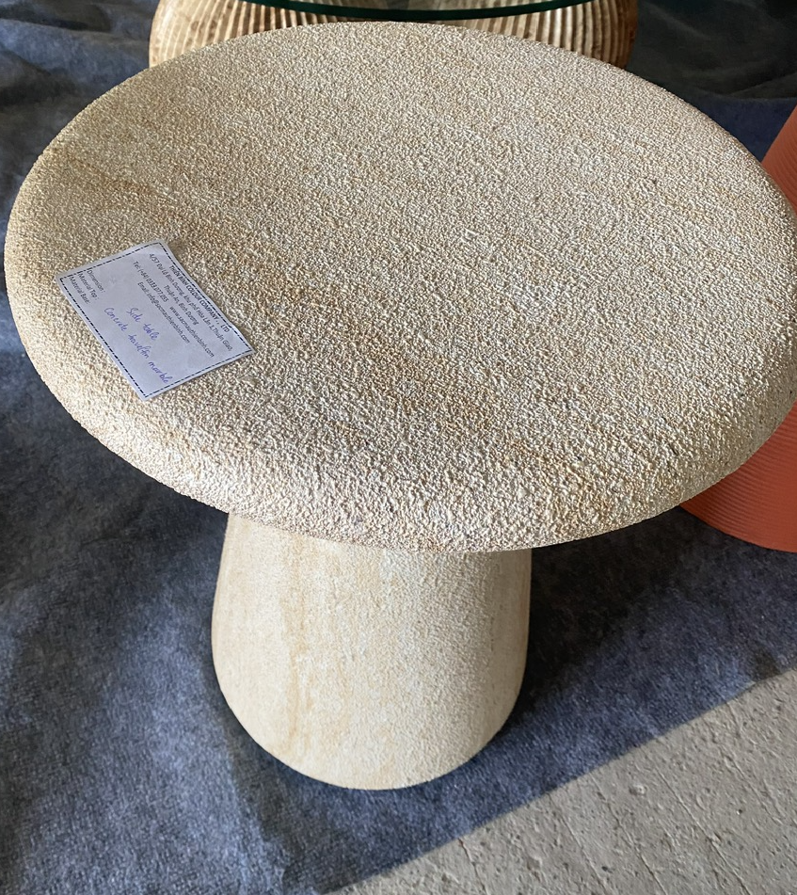
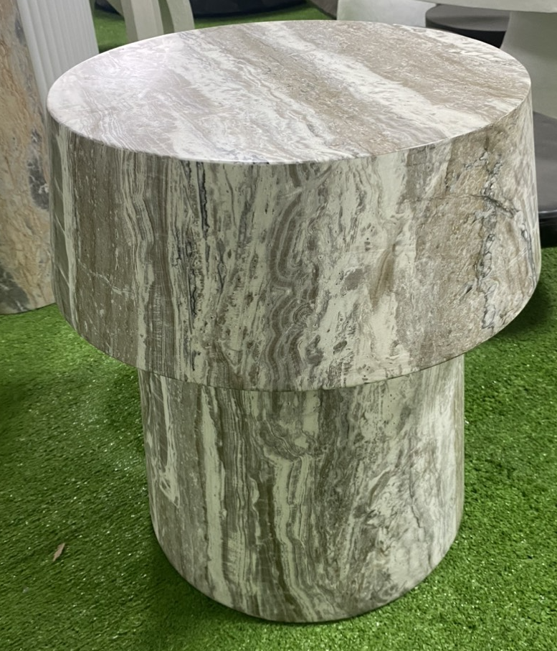
 | Round side Table The modern design carries the breath of immense nature. Bring nature into your home. PRODUCT DETAILS SKU: Collection: Item Weight : 20-25 kg Item Dimension : Dia 450 x 500H (mm) Carton Dimension : Color(s) : Touchable Ivory Material(s) : Concrete
 | Accent Table The modern design carries the breath of immense nature. Bring nature into your home PRODUCT DETAILS SKU: Collection: Item Weight : 25-35 kg Item Dimension : Dia 450 x 510H (mm) Carton Dimension : Color(s) : Faux marble Material(s) : Concrete

Slide 27
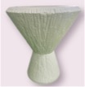
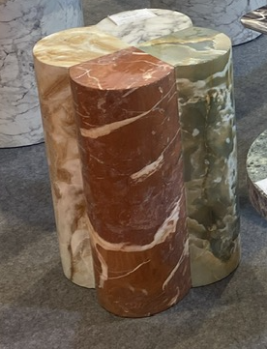
 | Round side Table The modern design carries the breath of immense nature. Bring nature into your home. PRODUCT DETAILS SKU: Collection: Item Weight : 25-30 kg Item Dimension : Dia 510 x 610H (mm) Carton Dimension : Color(s) : Touchable matt white Material(s) : Concrete
 | Acent Table The modern design carries the breath of immense nature. Bring nature into your home PRODUCT DETAILS SKU: Collection: Item Weight : 20-30 kg Item Dimension : Dia 406 x 588H (mm) Carton Dimension : Color(s) : Faux marble Material(s) : Concrete

Slide 28
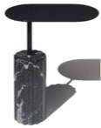

 | Round side Table The modern design carries the breath of immense nature. Bring nature into your home. PRODUCT DETAILS SKU: Collection: Item Weight : 25-30 kg Item Dimension : 508 x 220 x 609H (mm) Carton Dimension : Color(s) : Faux marble Material(s) : Top metal 5mm powder coating, Base Concrete faux marble
 | Round Coffe Table The modern design carries the breath of immense nature. Bring nature into your home PRODUCT DETAILS SKU: Collection: Item Weight : 35-40 kg Item Dimension : Dia 559 x 762H (mm) Carton Dimension : Color(s) : Natural cement Material(s) : Wood Top, Metal connect Concrete base

Slide 29

 | ACCENT TABLE The modern design carries the breath of immense nature. Bring nature into your home. PRODUCT DETAILS SKU: Collection: Item Weight : 30-35 kg Item Dimension : Dia 700 x 380H (mm) Carton Dimension : Color(s) : Faux marble Material(s) : Top metal 5mm powder coating, Base Concrete faux marble
 | ACCENT TABLE HIGH The modern design carries the breath of immense nature. Bring nature into your home PRODUCT DETAILS SKU: Collection: Item Weight : 25-30 kg Item Dimension : Dia 400 x 53H (mm) Carton Dimension : Color(s) : Faux marble Material(s) : Top metal 5mm powder coating, Base Concrete faux marble

